Slide 1
GETTING STARTED WITH HTML5

Slide 2
Structure of Web page
HTML5 introduces 28 new elements:
  <section>, <article>, <aside>, <hgroup>, <header>,
  <footer>, <nav>, <figure>, <figcaption>, <video>,
  <audio>, <source>, <embed>, <mark>,<progress>,
  <meter>, <time>, <ruby>, <rt>, <rp>,<wbr>,
  <canvas>, <command>, <details>,<summary>,
  <datalist>, <keygen>and <output>
An HTML page first starts with the DOCTYPE declaration
Notes:
Wondering what it takes to get started with html5?

Slide 3
Removed HTML5 Elements
The following HTML 4.01 elements has been removed from HTML5:
  <acronym> <applet> <basefont> <big> <center> <dir> <font> <frame> <frameset> <noframes> <strike> <tt>

Slide 4
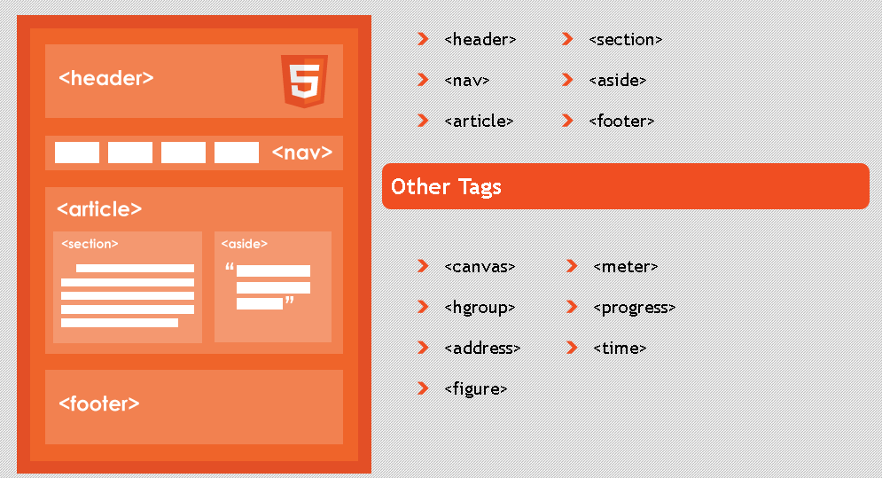
Structure of Web page
Notes:
Wondering what it takes to get started with html5?

Slide 5
HTML5 Semantic Elements
A semantic element clearly describes its meaning to both the browser and the developer.
Examples of semantic elements: <form>, <table>, and <img> - Clearly defines its content.
Examples of non-semantic elements: <div> and <span> - Tells nothing about its content.

Slide 6
First HTML5 Webpage
<!DOCTYPE html>
<html>
<head>
<title>Title of the document</title>
</head>
<body>
That’s all I need to create my first HTML5 page
</body>
</html>
Notes:
Wondering what it takes to get started with html5?

Slide 7
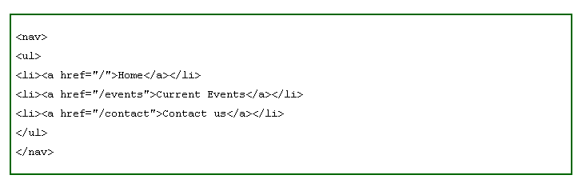
New Semantic Elements
<nav>: Represents a major navigation block. It groups links to other pages or to parts of the current page.
<nav> does not have to be used in every place you can find links.
For instance, footers often contains links to terms of service, copyright page and such, the <footer> element would be sufficient in that case
Notes:
Wondering what it takes to get started with html5?

Slide 8
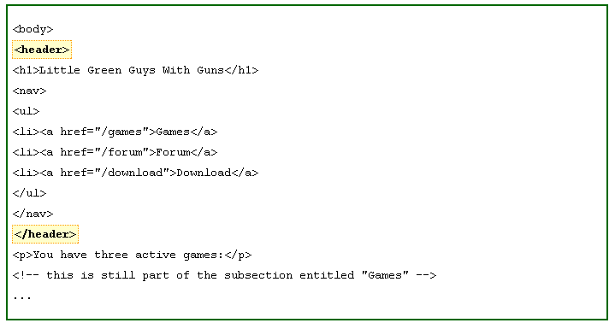
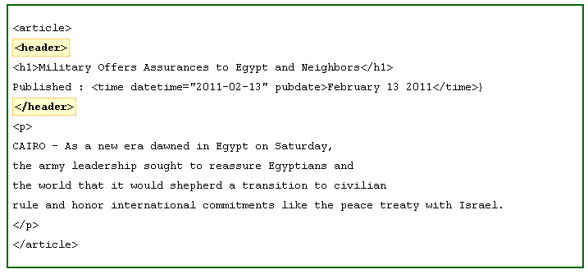
New Semantic Elements
<Header>: tag specifies a header for a document or section.
However, we mustn't think that "header" is only for masthead of a website. "header" can be use as a heading of an blog entry or news article as every article has its title and published date and time
Notes:
Wondering what it takes to get started with html5?

Slide 9
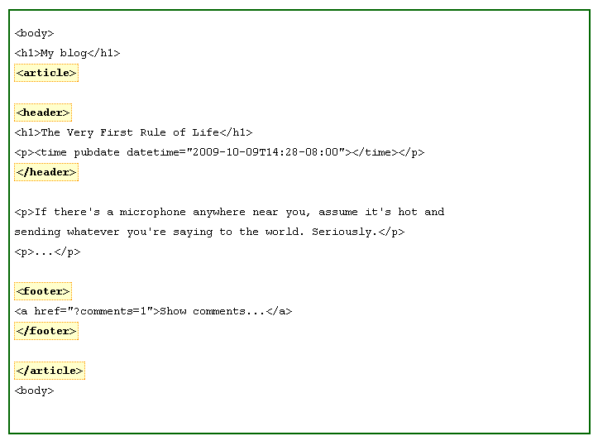
New Semantic Elements
<article>: The web today contains a ocean of news articles and blog entries. That gives W3C a good reason to define an element for article instead of <div class="article">.
We should use article for content that we think it can be distributable. Just like news or blog entry can we can share in RSS feed
Notes:
Wondering what it takes to get started with html5?

Slide 10
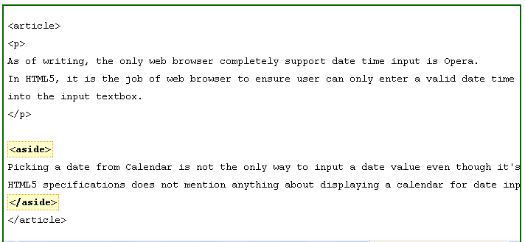
New Semantic Elements
<aside>: The "aside" element is a section that somehow related to main content, but it can be separate from that content
Notes:
Wondering what it takes to get started with html5?

Slide 11
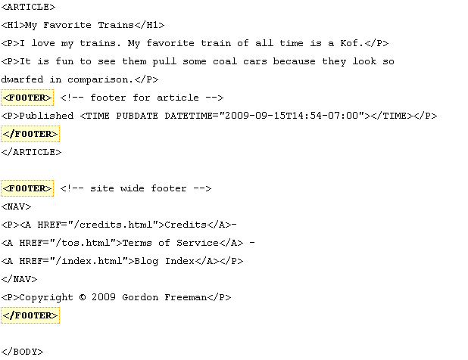
New Semantic Elements
<footer>: Similarly to "header" element, "footer" element is often referred to the footer of a web page.
Notes:
Wondering what it takes to get started with html5?

Slide 12
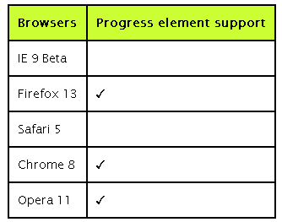
New Semantic Elements
<Progress>: The new "progress" element appears to be very similar to the "meter" element. It is created to indicate progress of a specific task.
The progress can be either determinate OR interderminate. Which means, you can use "progress" element to indicate a progress that you do not even know how much more work is to be done yet.
Progress of Task A : <progress value="60" max="100">60%</progress>
Notes:
Wondering what it takes to get started with html5?

Slide 13
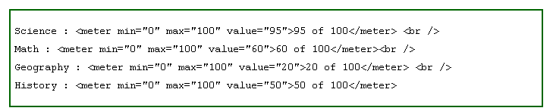
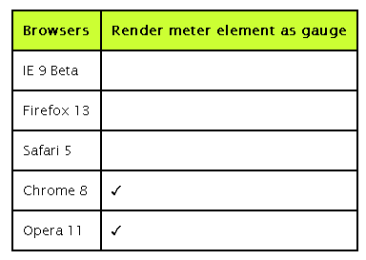
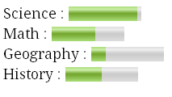
New Semantic Elements
<meter>: "Meter" is a new element in HTML5 which represents value of a known range as a gauge. The keyword here is "known range". That means, you are only allowed to use it when you are clearly aware of its minimum value and maximum value.
One example is score of rating: <meter min="0" max="10" value="8">8 of 10</meter>.
Notes:
Wondering what it takes to get started with html5?

Slide 14

New Semantic Elements
<mark>: The mark <mark> element represents a run of text in one document marked or highlighted for reference purposes, due to its relevance in another context.
Basically, it is used to bring the reader's attention to a part of the text that might not have been
Notes:
Wondering what it takes to get started with html5?

Slide 15

New Semantic Elements
<figure>: The <figure> tag specifies self-contained content, like illustrations, diagrams, photos, code listings, etc.
While the content of the <figure> element is related to the main flow, its position is independent of the main flow, and if removed it should not affect the flow of the document
Notes:
Wondering what it takes to get started with html5?

Slide 16

HTML 5 audio & video

Slide 17

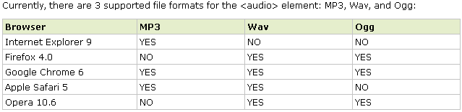
Audio & video
<audio>
Until now, there has not been a standard for playing audio files on a web page.
Today, most audio files are played through a plug-in (like flash). However, different browsers may have different plug-ins.
HTML5 defines a new element which specifies a standard way to embed an audio file on a web page: the <audio> element.
Notes:
Wondering what it takes to get started with html5?

Slide 18
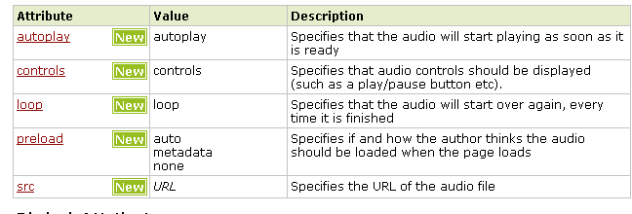
Audio & video
<audio attributes >
Notes:
Wondering what it takes to get started with html5?

Slide 19
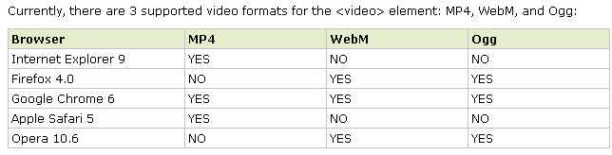
Audio & video
<video>
Until now, there has not been a standard for showing a video/movie on a web page.
Today, most videos are shown through a plug-in (like flash). However, different browsers may have different plug-ins.
HTML5 defines a new element which specifies a standard way to embed a video/movie on a web page: the <video> element.
Notes:
Wondering what it takes to get started with html5?

Slide 20
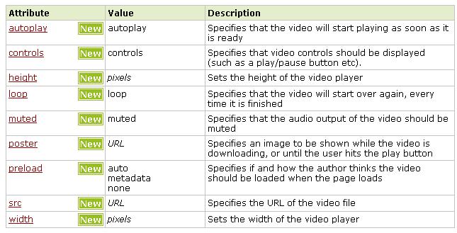
Audio & video
<video attributes>
Notes:
Wondering what it takes to get started with html5?

Slide 21
HTML 5 canvas

Slide 22
Canvas
With HTML5’s Canvas API, we’re no longer limited to drawing rectangles on our sites.
We can draw anything we can imagine, all through JavaScript. This can improve the performance of our websites by avoiding the need to download images off the network.
With canvas, we can draw shapes and lines, arcs and text, gradients and patterns. In addition, canvas gives us the power to manipulate pixels in images and even video.
The Canvas 2D Context spec is supported in:
■ Safari 2.0+
■ Chrome 3.0+
■ Firefox 3.0+
■ Internet Explorer 9.0+
■ Opera 10.0+
■ iOS (Mobile Safari) 1.0+
■ Android 1.0+
Notes:
Wondering what it takes to get started with html5?

Slide 23
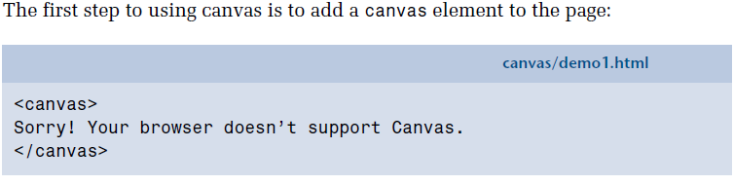
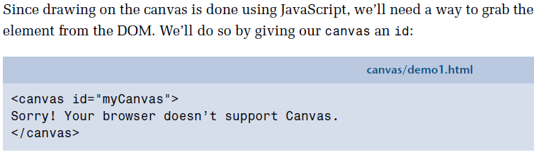
Canvas
Creating a canvas Element
Onload of the page we triggering draw(); method
Notes:
Wondering what it takes to get started with html5?

Slide 24
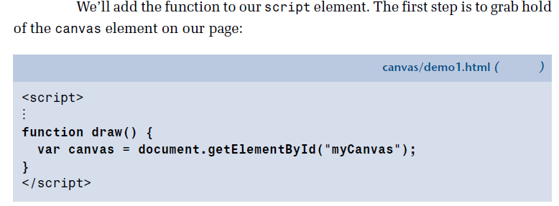
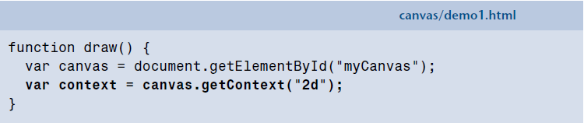
Canvas
Drawing a canvas
We obtain our drawing context by calling the getContext method and passing it the string "2d", since we’ll be drawing in two dimensions:
Notes:
Wondering what it takes to get started with html5?

Slide 25
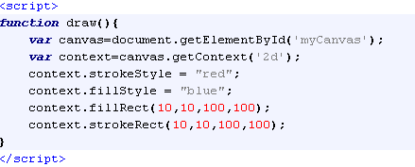
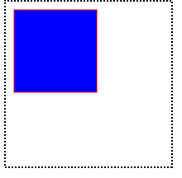
Canvas
Filling brush with color
Notes:
Wondering what it takes to get started with html5?

Slide 26
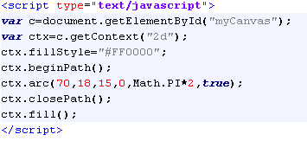

Canvas
Create circle using canvas
Output
Notes:
Wondering what it takes to get started with html5?

Slide 27
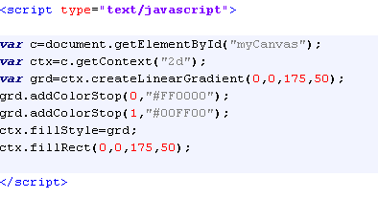
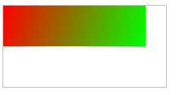
Canvas
Create linear gradient
Output
Notes:
Wondering what it takes to get started with html5?

Slide 28
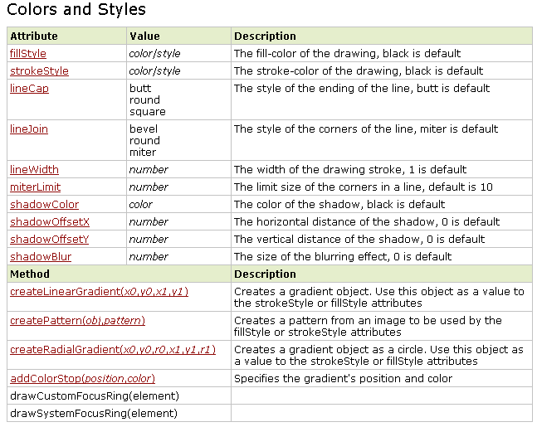
Canvas
Notes:
Wondering what it takes to get started with html5?

Slide 29
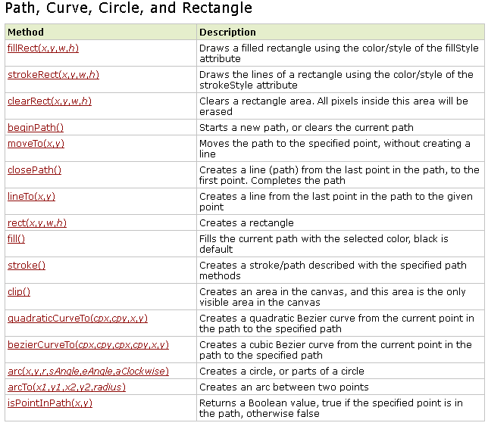
Canvas
Notes:
Wondering what it takes to get started with html5?

Slide 30
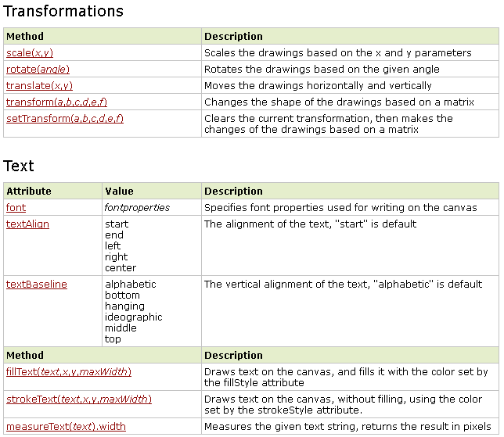
Canvas
Notes:
Wondering what it takes to get started with html5?

Slide 31
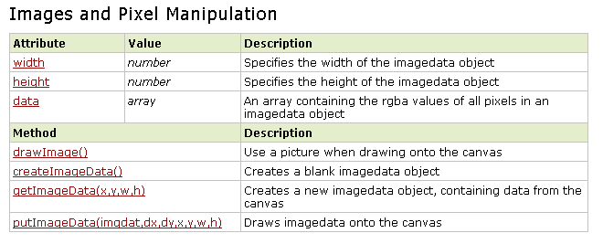
Canvas
Notes:
Wondering what it takes to get started with html5?

Slide 32
HTML 5 Geo location

Slide 33
Geolocation
The first new API we’ll cover is geolocation. Geolocation allows your visitors to share their current location.
Depending on how they’re visiting your site, their location may be determined by any of the following:
■ IP address
■ wireless network connection
■ cell tower
■ GPS hardware on the device
Privacy Concerns
Not everyone will want to share their location with you, as there are privacy concerns inherent to this information. Thus, your visitors must opt in to share their location.
Nothing will be passed along to your site or web application unless the user agrees.
The decision is made via a prompt at the top of the browser. Figure 10.1 shows what this prompt looks like in Chrome.
Notes:
Wondering what it takes to get started with html5?

Slide 34
Geolocation
Using geolocation
With geolocation, you can determine the user’s current position. You can also be notified of changes to their position, which could be used, for example, in a web application that provided real-time driving directions.
Geolocation: methods
These different tasks are controlled through the three methods currently available
in the Geolocation API:
■ getCurrentPosition
■ watchPosition
■ clearPosition
Notes:
Wondering what it takes to get started with html5?

Slide 35
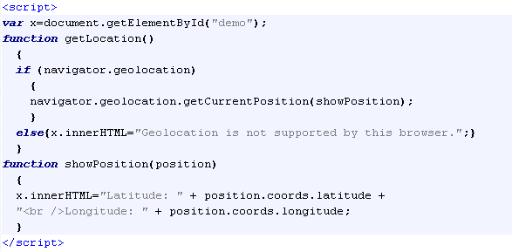
Geolocation
Using geolocation
The example below is a simple Geolocation example returning the latitude and longitude of the user's position:
Check if Geolocation is supported
If supported, run the getCurrentPosition() method. If not, display a message to the user
If the getCurrentPosition() method is successful, it returns a coordinates object to the function specified in the parameter ( showPosition )
The showPosition() function gets the displays the Latitude and Longitude
Notes:
Wondering what it takes to get started with html5?

Slide 36
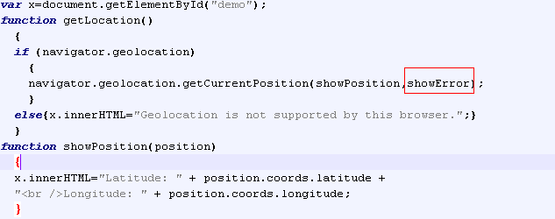
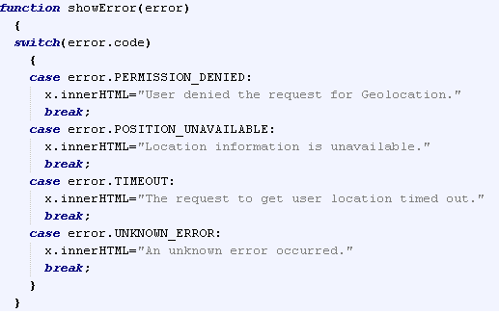
Geolocation
Using geolocation
The example below is a simple Geolocation example returning the latitude and longitude of the user's position with error handling:
Notes:
Wondering what it takes to get started with html5?

Slide 37
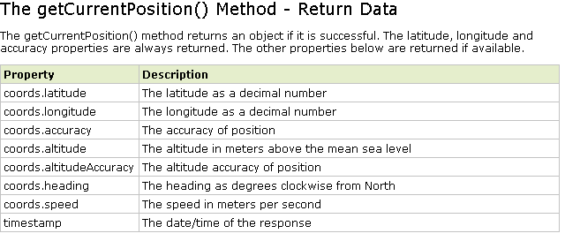
Geolocation
Using geolocation

